Slide 1
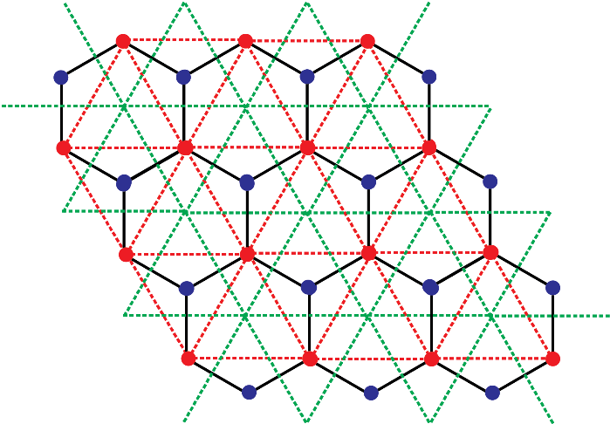
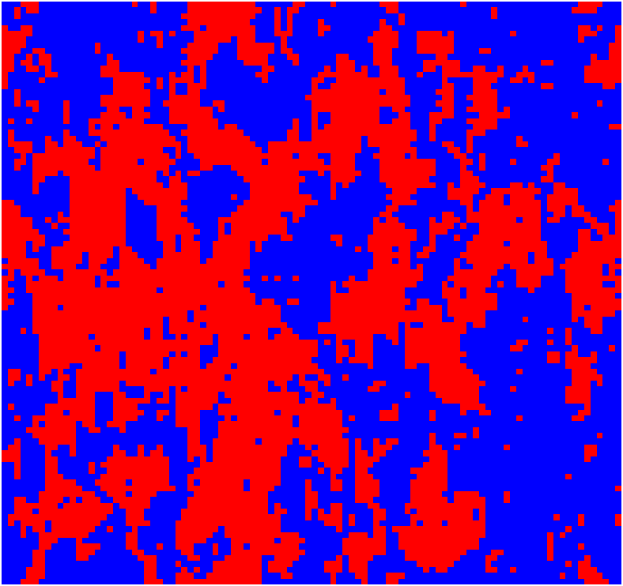
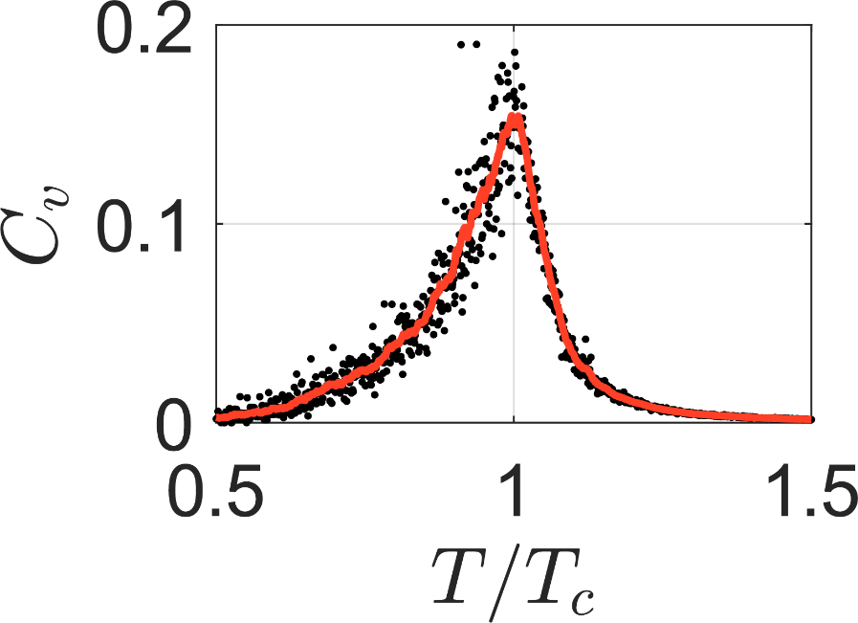
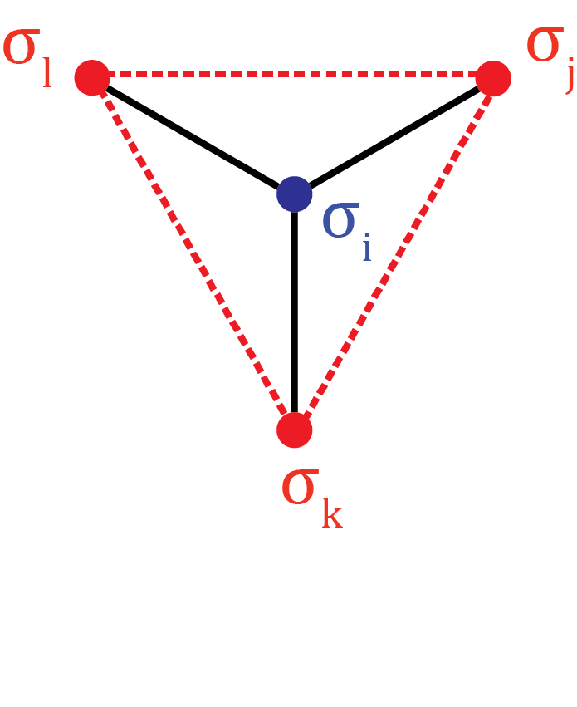
Critical Point of a 2D Ising Honeycomb Lattice in Zero External Field
Rishav Koirala, Haotian Song
Project Presentation PC5202 Advanced Statistical Mechanics

Slide 2
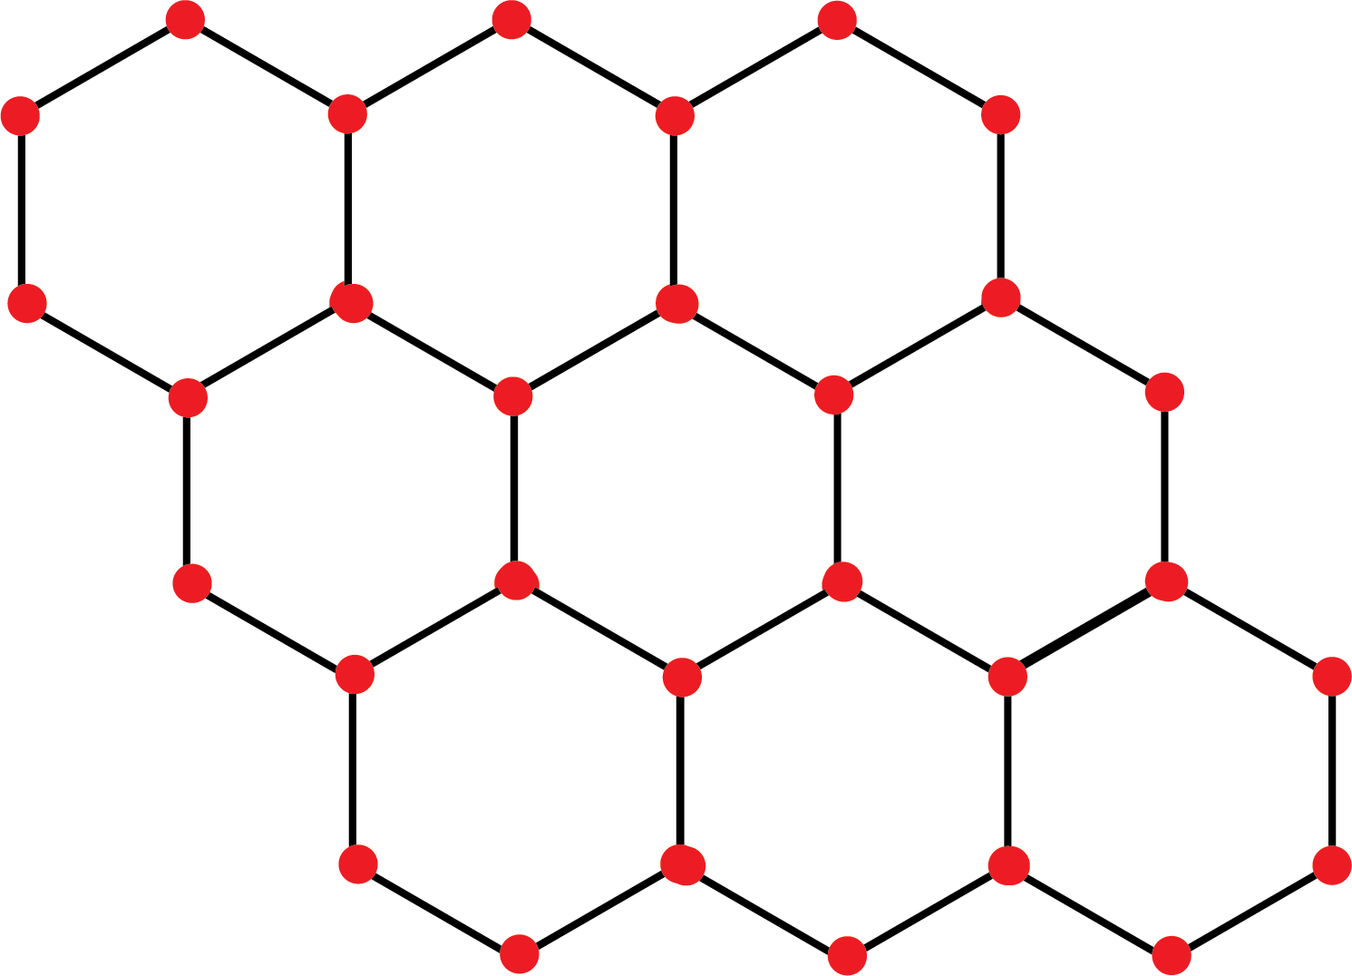
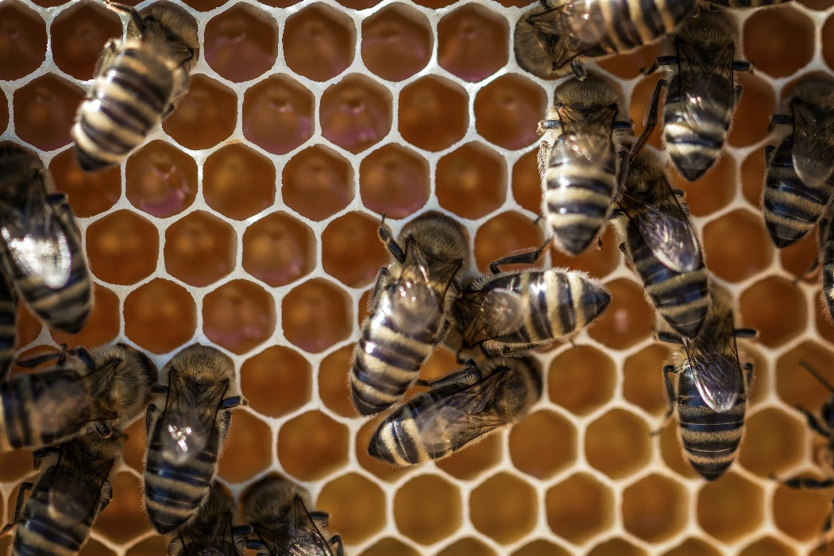
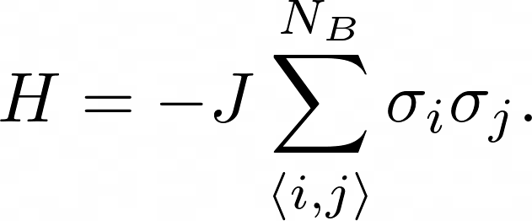
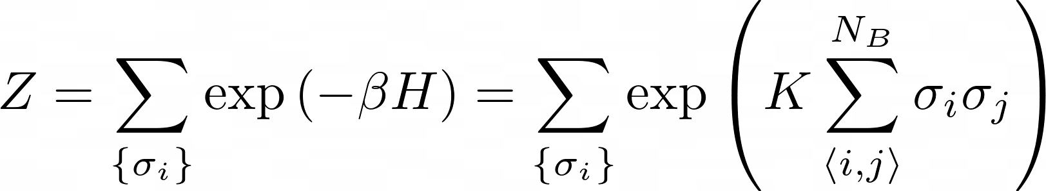
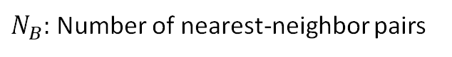

Introduction
Very widely-studied geometry. Important applications – e.g., graphene.
Next simplest lattice after the square net – considerable pedagogical interest.
Displays phase transition at a critical point.
Our aim:
Derive the critical point theoretically
Derive the critical point via computer simulation
Investigate the behavior of the critical point in case of missing spins and impurities.
$$K=βJ$$
$N_{B}:$ Number of nearest-neighbor pairs

Slide 3
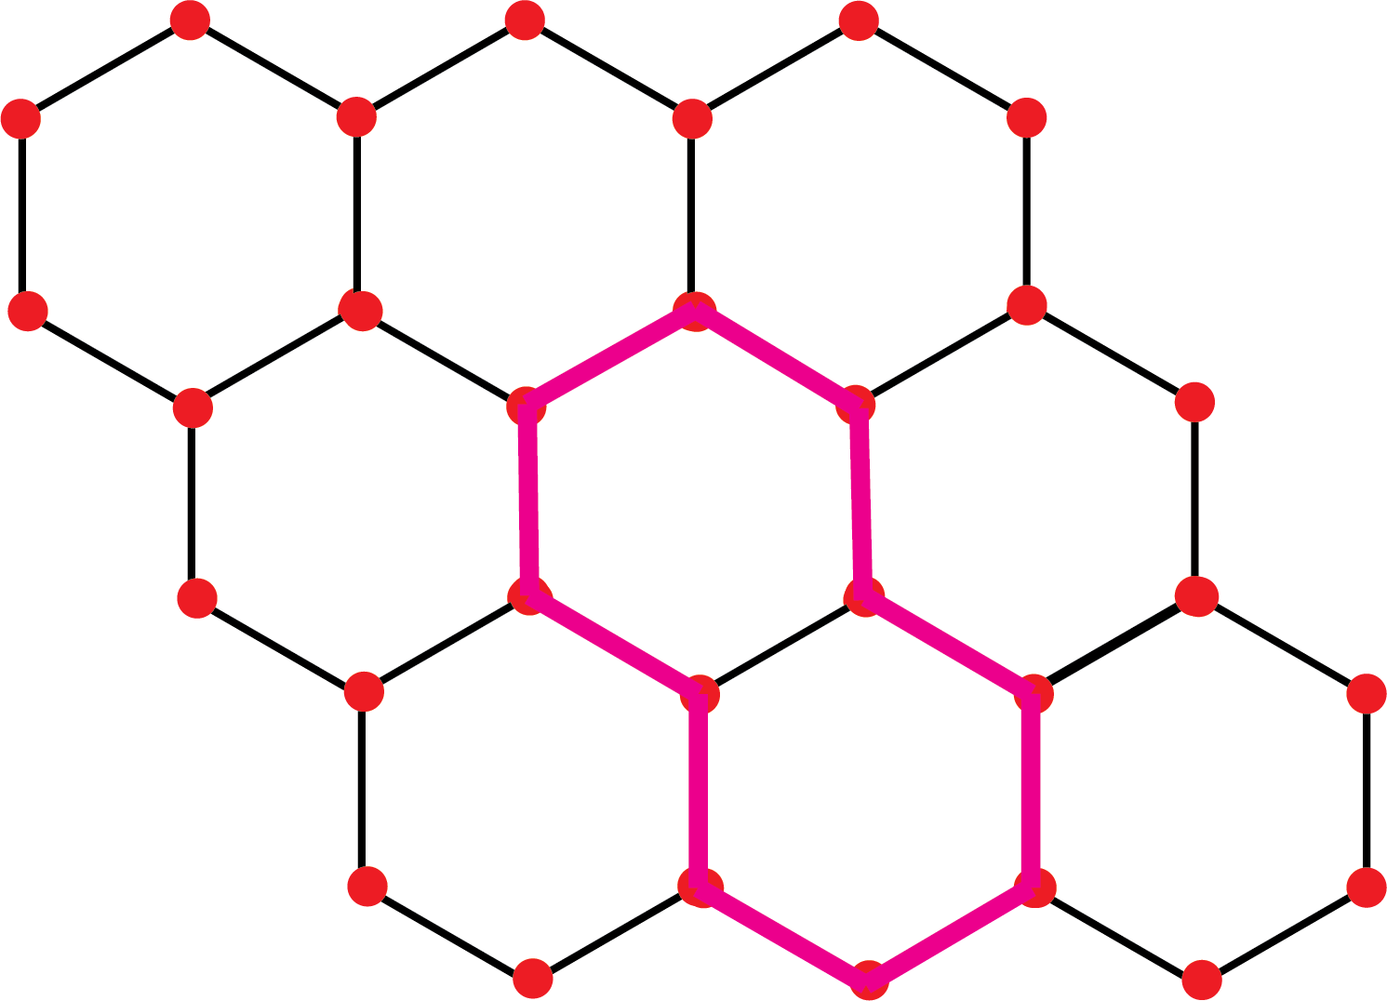
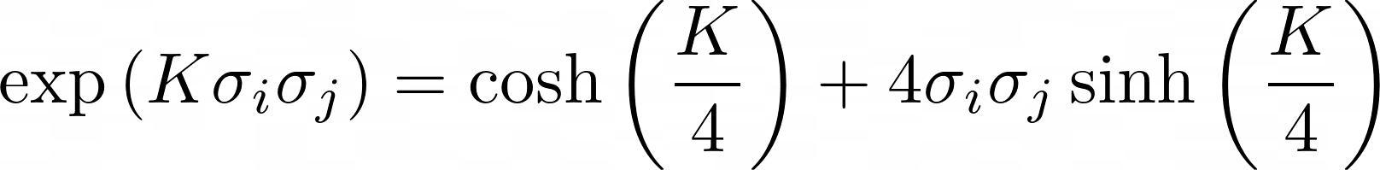
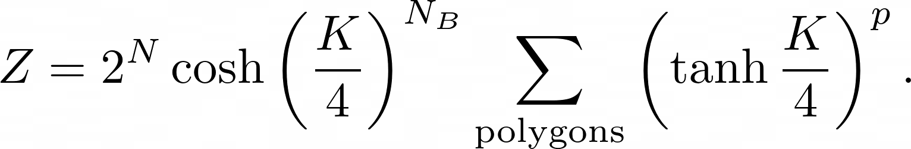
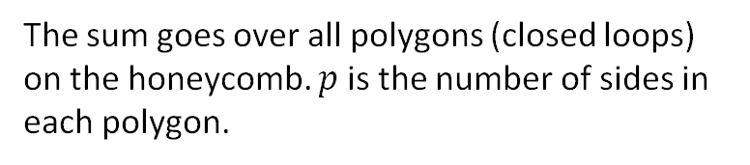
Partition Function – High Temperature Model
The sum goes over all polygons (closed loops) on the honeycomb. $p$ is the number of sides in each polygon.
A polygon of side 10 (pink) on the honeycomb.

Slide 4
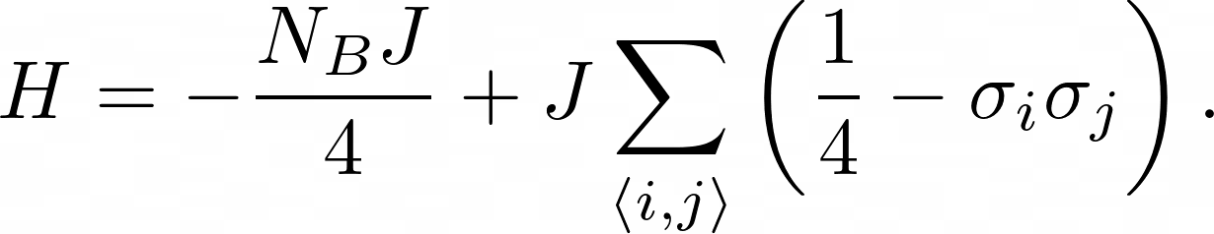
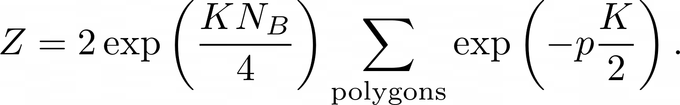
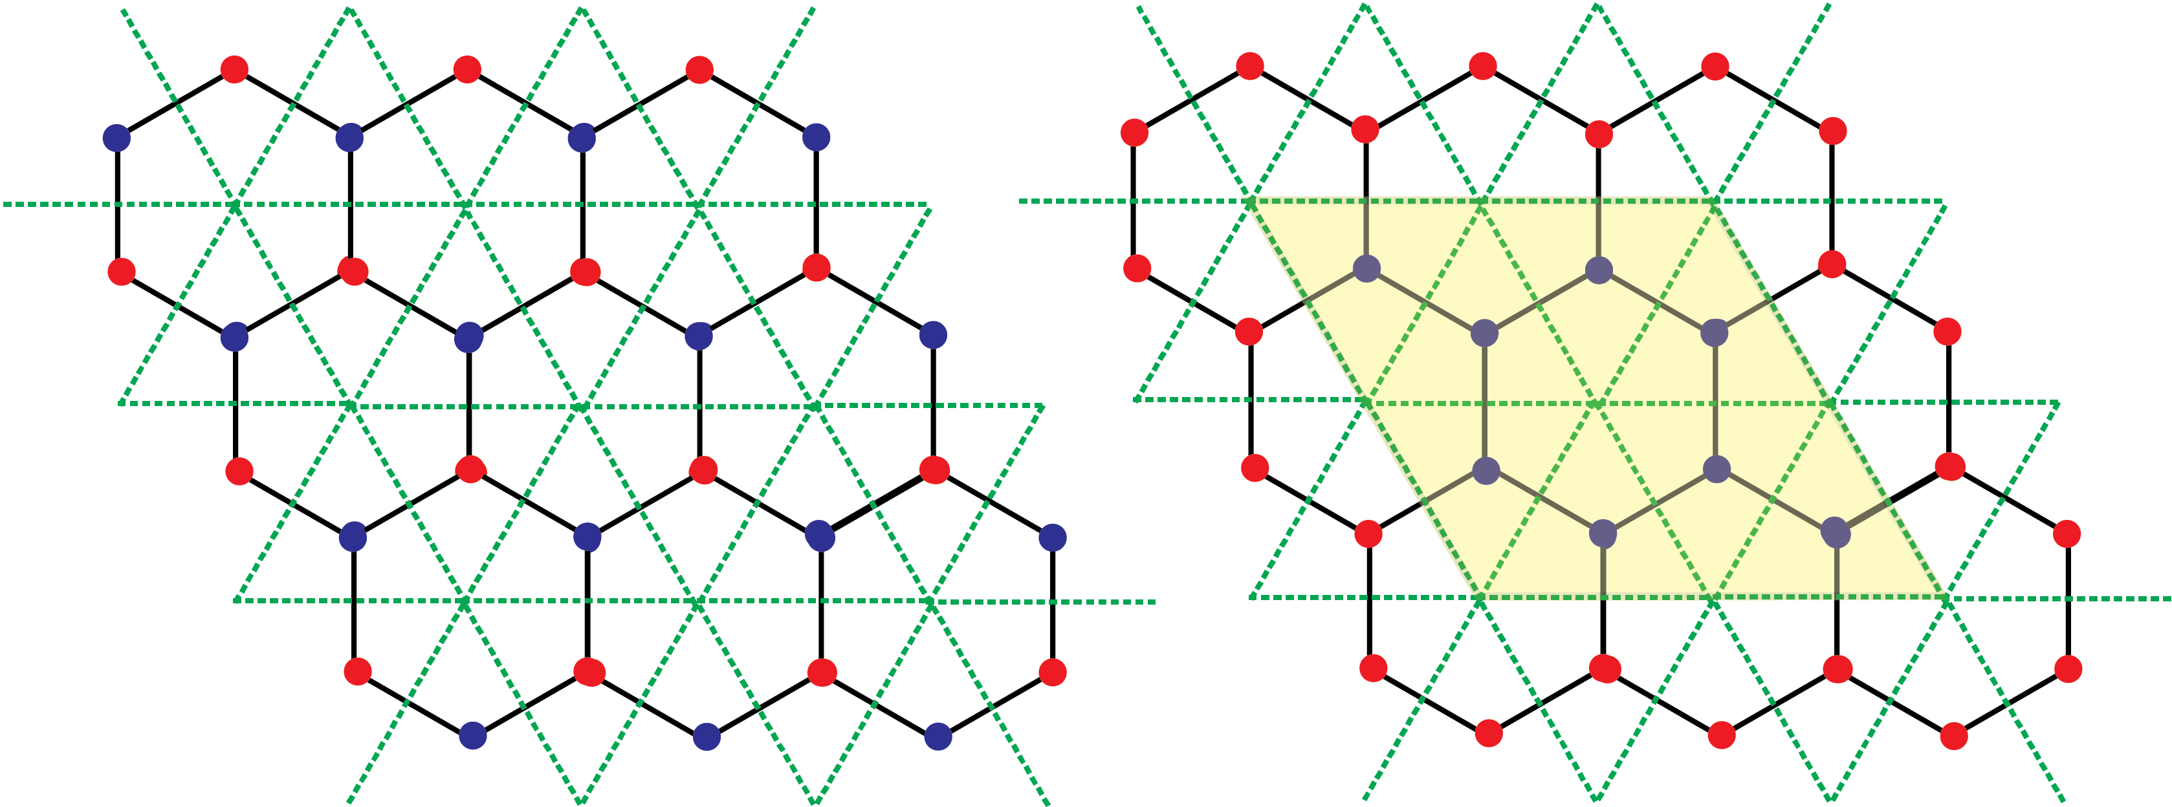
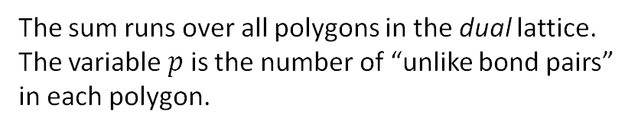
Partition Function – Low Temperature Model
The sum runs over all polygons in the dual lattice. The variable $p$ is the number of “unlike bond pairs” in each polygon.
A polygon (shaded yellow) containing 8 spins on the dual triangular lattice.

Slide 5
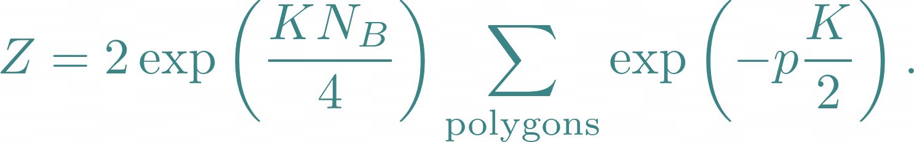
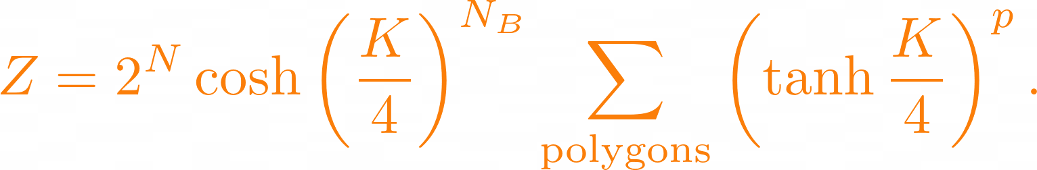
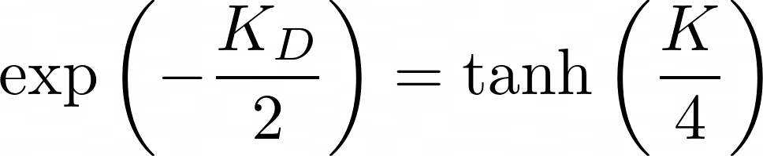
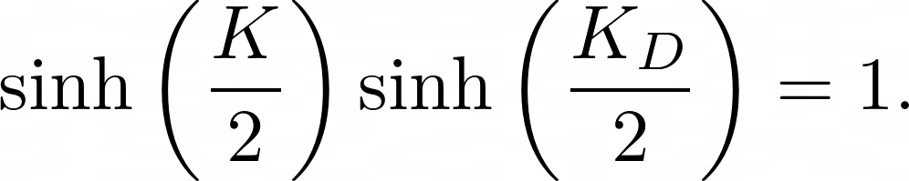
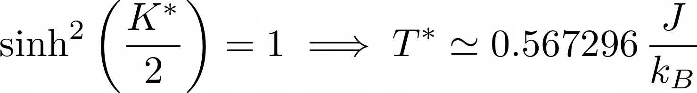
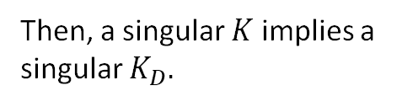
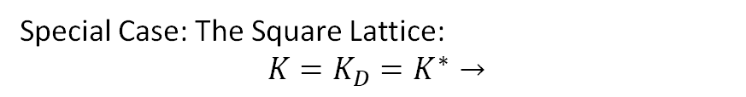
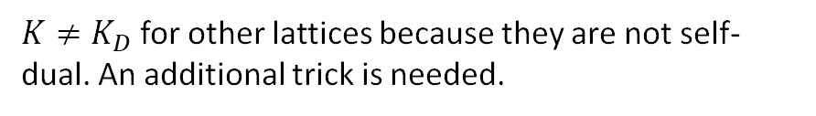
Duality Relation
Low-Temperature
High-Temperature
If
or
Special Case: The Square Lattice:
$$K=K_{D}=K^{∗}→$$
Then, a singular $K$ implies a singular $K_{D}.$
$K≠K_{D}$ for other lattices because they are not self-dual. An additional trick is needed.

Slide 6
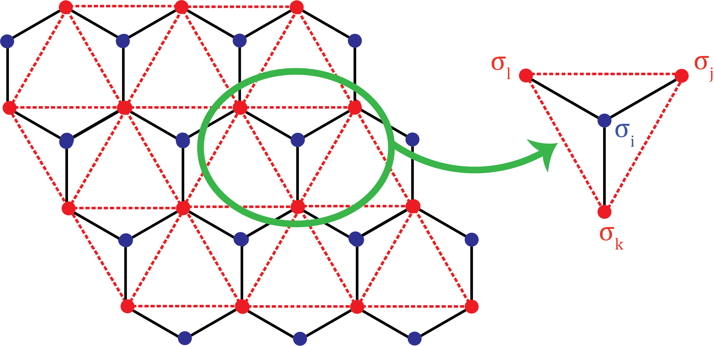
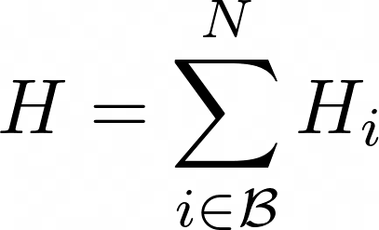
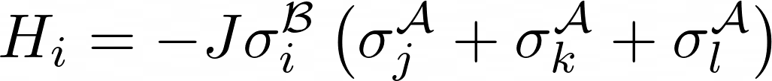
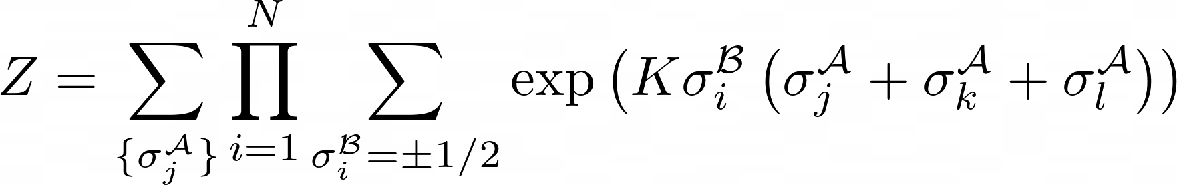
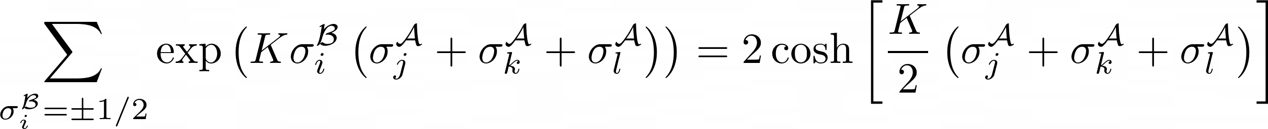
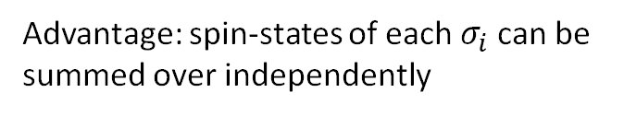
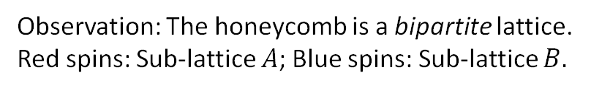
Star-Triangle Transformation I
Observation: The honeycomb is a bipartite lattice.
Red spins: Sub-lattice $A$; Blue spins: Sub-lattice $B.$
Advantage: spin-states of each $σ_{i}$ can be summed over independently

Slide 7
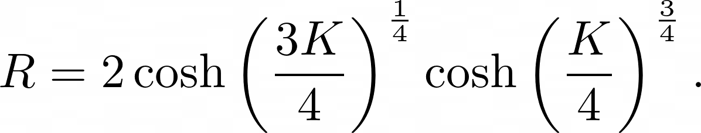
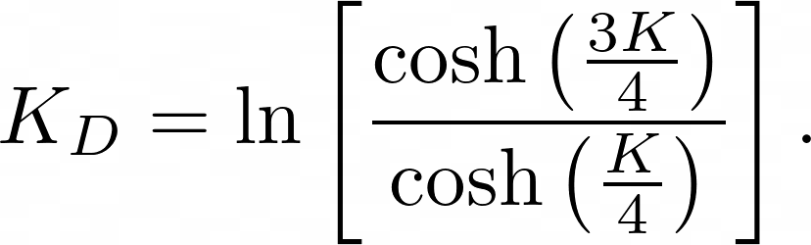
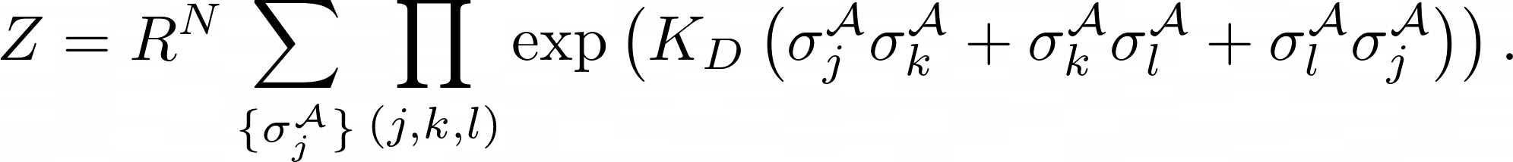
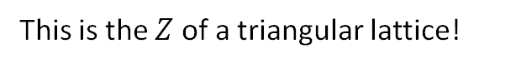
Star-Triangle Transformation II
Main Idea:
Physical meaning: Replace interactions of spin $σ_{i}$ with neighboring spins $σ_{j},σ_{k}$, $σ_{l}$ by interactions among $σ_{j},σ_{k}$, $σ_{l}$ themselves.
This is the $Z$ of a triangular lattice!

Slide 8

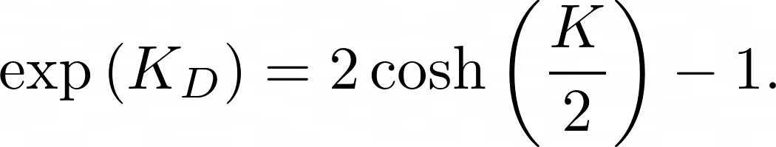
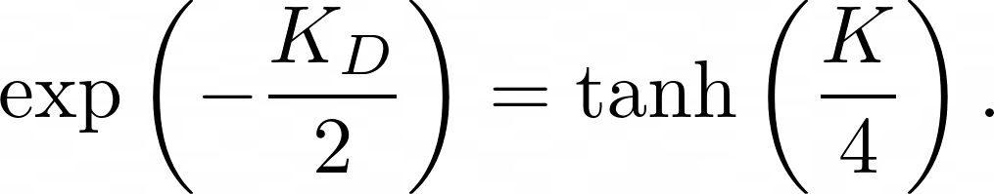
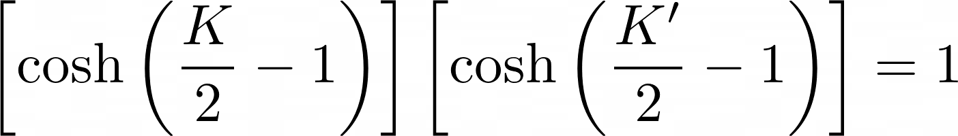
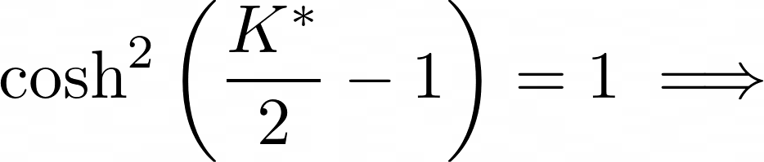
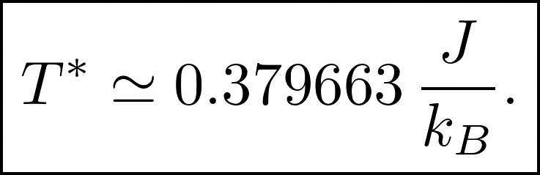
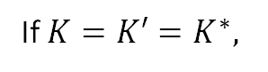
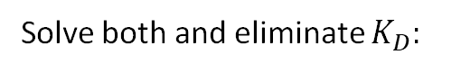
The Critical Point
Rewrite:
The dual lattice and the S.T.T. lattice are the same lattice!
From duality earlier:
From duality:
Solve both and eliminate $K_{D}:$
If $K=K′=K^{∗},$

Slide 9
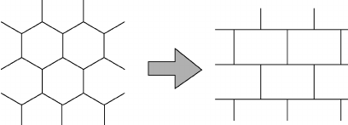
The transformation to a brick lattice
(1,1)
(1,3)
(1,5)
(1,1)
(1,3)
(1,5)
(1,2)
(1,4)
(1,2)
(1,4)
(2,2)
(2,4)
(2,2)
(2,4)
(2,1)
(2,3)
(2,5)
(2,1)
(2,3)
(2,5)
(3,1)
(3,3)
(3,5)
(3,1)
(3,3)
(3,5)
(3,2)
(3,4)
(3,2)
(3,4)
Wakabayashi, Katsunori, Mitsutaka Fujita, Hiroshi Ajiki, and Manfred Sigrist (Mar. 1999). “Electronic and magnetic properties of nanographite ribbons”. In: Phys. Rev. B 59 (12), pp. 8271–8282.
Notes:
I will talk about how we can simulate the honeycomb lattice numerically. To begin with, we need to simplify the honeycomb lattice. We transform the honeycomb lattice into the brick lattice as shown in this figure and each lattice site corresponds to one site in brick lattice. The only difference is their shape. But their interactions and neighbours are still the same. In this case, they are the same lattice mathematically. Then we can label them just like square lattice with one missing neighbour. First row first column.
As you can see in this figure, each site has three neighbours, one is on the laft side , one is on the right. The third one is either on the top or on the bottom. The summation of that depends how it behaves.

Slide 10
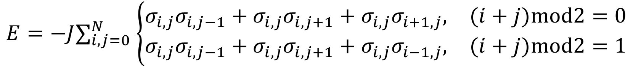
The transformation to a brick lattice
Right
Left
Bottom
$$E=−J∑_{i,j=0}^{N} \left\{\begin{matrix}σ_{i,j}σ_{i,j−1}+σ_{i,j}σ_{i,j+1}+σ_{i,j}σ_{i+1,j}, & (i+j)mod2=0 \\ σ_{i,j}σ_{i,j−1}+σ_{i,j}σ_{i,j+1}+σ_{i,j}σ_{i−1,j}, & (i+j)mod2=1\end{matrix}\right.$$
Right
Left
Top
Wakabayashi, Katsunori, Mitsutaka Fujita, Hiroshi Ajiki, and Manfred Sigrist (Mar. 1999). “Electronic and magnetic properties of nanographite ribbons”. In: Phys. Rev. B 59 (12), pp. 8271–8282.
Notes:
Then We can wirte down the formula for the energy of honeycomb lattice (or brick lattice). It’s the summation of all the lattice sites’ interactions and each lattice site has three interaction with its neighbors. The special part is that if the summation of their column and row index is even, it has the neighbour on the top. Otherwise, it has the neighbour on the bottom.

Slide 11
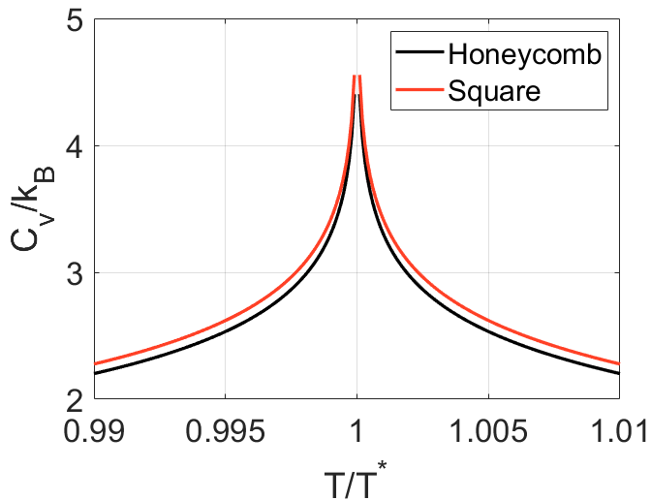
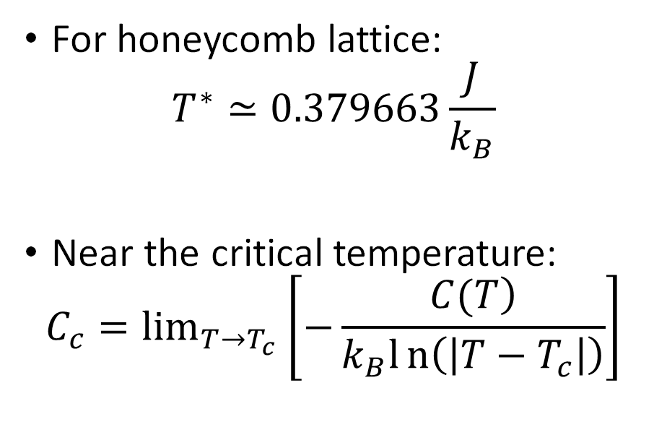
Numerical solution
For honeycomb lattice:
$$T^{∗}≃0.379663\frac{J}{k_{B}}$$
Near the critical temperature:
$$C_{c}=\lim_{T→T_{c}} \left[−\frac{\left.C(T\right)}{k_{B}ln\left(\left|T−T_{c}\right|\right)}\right]$$
Houtappel, Raymond Marie Ferdinand (1950). “Order-disorder in hexagonal lattices”. In Physica 16.5, pp. 425–455.
Notes:
As we mentioned before, the critical temperature ahs been derived by theory and People in the past has also predicted the behaviour near the critical temperature and it is logarithm increase for both square and honeycomb lattices. If we can simulate and derive the specific heat or susceptibility, the infinite point is at the critical temperature.

Slide 12
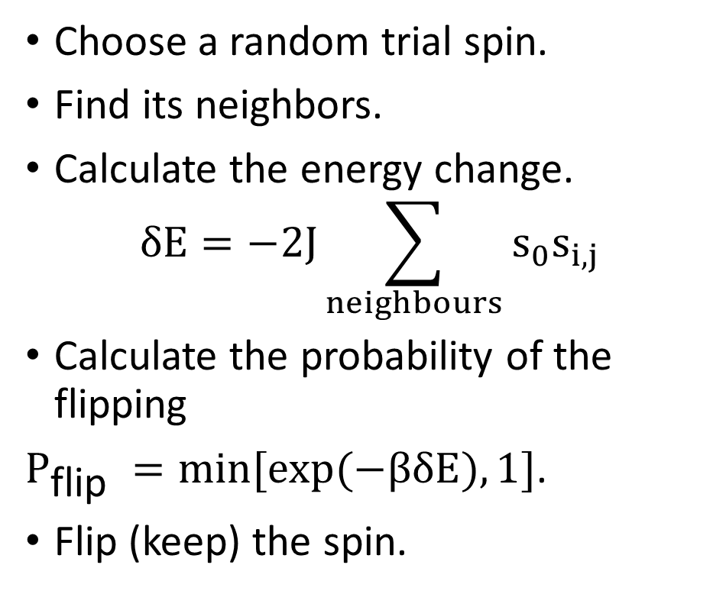
The Metropolis-Hastings Algorithm
Choose a random trial spin.
Find its neighbors.
Calculate the energy change.
$$δE=−2J\sum_{neighbours}{s_{0}s_{i,j}}$$
Calculate the probability of the flipping
$P_{\text{flip} }=min[exp(−βδE),1]$.
Flip (keep) the spin.
The simulation codes are available at https://github.com/wonderingmark123/Ising-Model-Honeycomb
Notes:
To do the simulation ,we used the Metropolis-Hastings algorithm, which falls under the larger class of Monte-Carlo Methods. It will generate random process to predict a system in large scale.

Slide 13
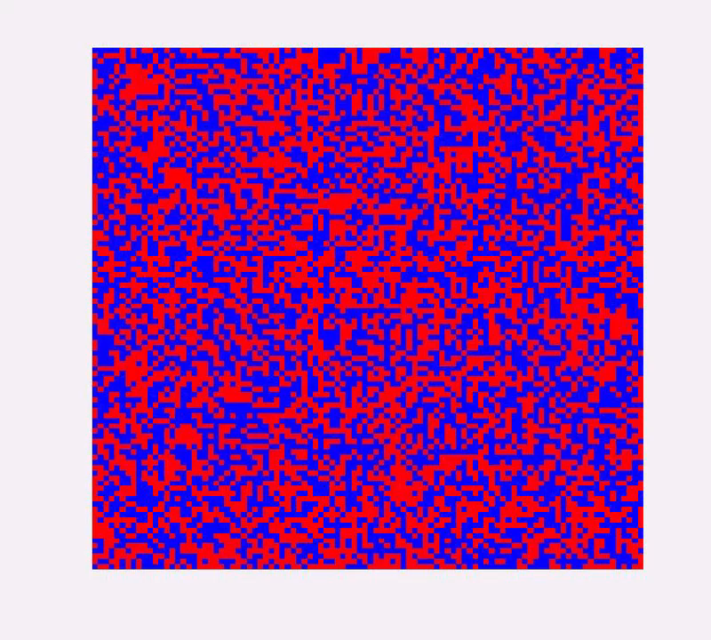
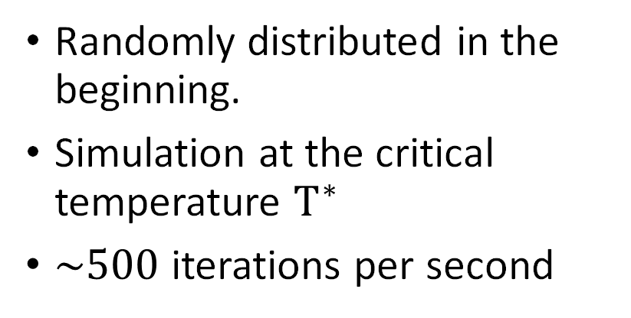
The Metropolis-Hastings Algorithm
Randomly distributed in the beginning.
Simulation at the critical temperature $T^{∗}$
$\sim 500$ iterations per second

Slide 14



The Metropolis-Hastings Algorithm
0 iteration
Initial condition
$3×{10}^{4}$ iterations
$6×{10}^{5}$ iterations
Notes:
In the beginning , the spins are randomly distributed. After 30 thousands iteration, small clusters has formed . After 600 thousands iterations, larger clusters will from and gradually reach the equilibrium.

Slide 15


Thermodynamical properties
$$E=−J∑_{i,j=0}^{N} \left\{\begin{matrix}σ_{i,j}σ_{i,j−1}+σ_{i,j}σ_{i,j+1}+σ_{i,j}σ_{i+1,j}, & (i+j)mod2=0 \\ σ_{i,j}σ_{i,j−1}+σ_{i,j}σ_{i,j+1}+σ_{i,j}σ_{i−1,j}, & (i+j)mod2=1\end{matrix}\right.$$
$$\begin{matrix}Magnetization: & M=∑_{i,j=0}^{N} s_{i,j} \\ Specific heat: & C=\frac{1}{k_{B}T^{2}}\left(\left\langle E^{2}\right\rangle −⟨E⟩^{2}\right) \\ Susceptibility: & χ=\frac{1}{k_{B}T}\left(\left\langle M^{2}\right\rangle −⟨M⟩^{2}\right)\end{matrix}$$
Notes:
Now, we have the system in equilibrium at certain temperature. The thermodynamics properties could be calculated from the spins in that system.
To be noticed, since we have the equilibrium system, if we continue the iteration, Their will be some fluctuation in the system. Then our energy and magnetization is the average of those fluctuations. Furthermore, our specific heat and susceptibility represents the fluctuation of our energy and magnetization respectively. In this case, we continue our simulation after equilibrium and calculate the mean value and fluctuations.

Slide 16


Simulation Results: Honeycomb Lattice
$30×30$ spins in the lattice.
$9×{10}^{6}$ iterations.
${10}^{3}$ sample averages per temperature.
$T^{∗}≃0.379663\frac{J}{k_{B}}$from theory.
Notes:
Here are our simulation results. We choose 900 lattice sites and completed 9 million iterations per temperature…..

Slide 17

Simulation Results: Honeycomb Lattice
Energy increase dramatically near the critical temperature.
Magnetization decay from $±1$ to 0 after critical temperature.
Specific heat and susceptibility reach the maximum near the critical temperature.

Slide 18


Derive the statistical average
Notes:
This is one of our simulation result on the honeycomb lattice. As yo ucan see, the trend is obvious but there are lots of simulation error. Our sulotion for this is that for various temperatures, we choose a window. For example, we choose T over Tc is 0.9 . Two straight red lines are the window. Then we do the average of the points inside the window, and consider that as the specific heat at this temperature.

Slide 19

Simulation Results: Honeycomb Lattice
From specific heat:
$$T_{sim}^{∗}=0.3857±0.0040\frac{J}{k_{B}}$$
From susceptibility:
$$T_{sim}^{∗}=0.3785±0.0044\frac{J}{k_{B}}$$
Theoretical critical temperature:
$$T^{∗}≃0.379663\frac{J}{k_{B}}$$

Slide 20

Simulation Results: Honeycomb with “Holes”
1J
1J
0J
0J
1J
0J
0J
0J
Notes:
Then we tried to simulate the properties of Honeycomb lattice with defects. Firstly, we took out some spins from the honeycomb lattice, for example, in the left figure, then the interaction between holes and its neighbors is 0. The others remains the same.

Slide 21
Simulation Results: Honeycomb with “Holes”
Interaction energies near “holes” are 0.
Linear decrease until 25%.
After 30%, two critical temperature trends do not overlap.
Notes:
Here P is the percentage of holes in the honeycomb lattice.

Slide 22

Simulation Results: Honeycomb with Impurities
1J
2J
4J
1J
4J
2J
2J
Notes:
Here is the results for the honeycomb lattice with impurities. We assume that interaction is double at impurities’ sites.

Slide 23

Simulation Results: Honeycomb with Impurities
$σ_{i,impurity}=2σ_{i}$
monotonic increase from 0% to 100%
$4T^{∗}$ at 100% impurity is expected

Slide 24
Thank you

